Slide 1
VICTIMS OF RAPE IN INDIA

Slide 2
RAPE - THE MOST PREVALENT CRIME IN INDIA
Rape is the fourth most common crime against women in India. According to the National Crime Records Bureau (NCRB) 2013 annual report, 24,923 rape cases were reported across India in 2012. Out of these, 24,470 were committed by someone known to the victim (98% of the cases).
Many rapes go unreported in various countries including India. In India, consensual sex given on the false promise of marriage constitutes rape. The willingness to report the rape has increased in recent years, after several incidents of rape received widespread media attention and triggered public protest.

Slide 3
MOTIVATION
Since sexual abuse has been one of the most horrifying crimes since time immemorial, given the recent events taking place in our country - the Nirbhaya Case, the Kathua Case and so on - we felt that this would be a very relevant theme via which we can spread even more awareness to people. This issue is of utmost importance to us, both as responsible citizens of this country and as growing women.

Slide 4
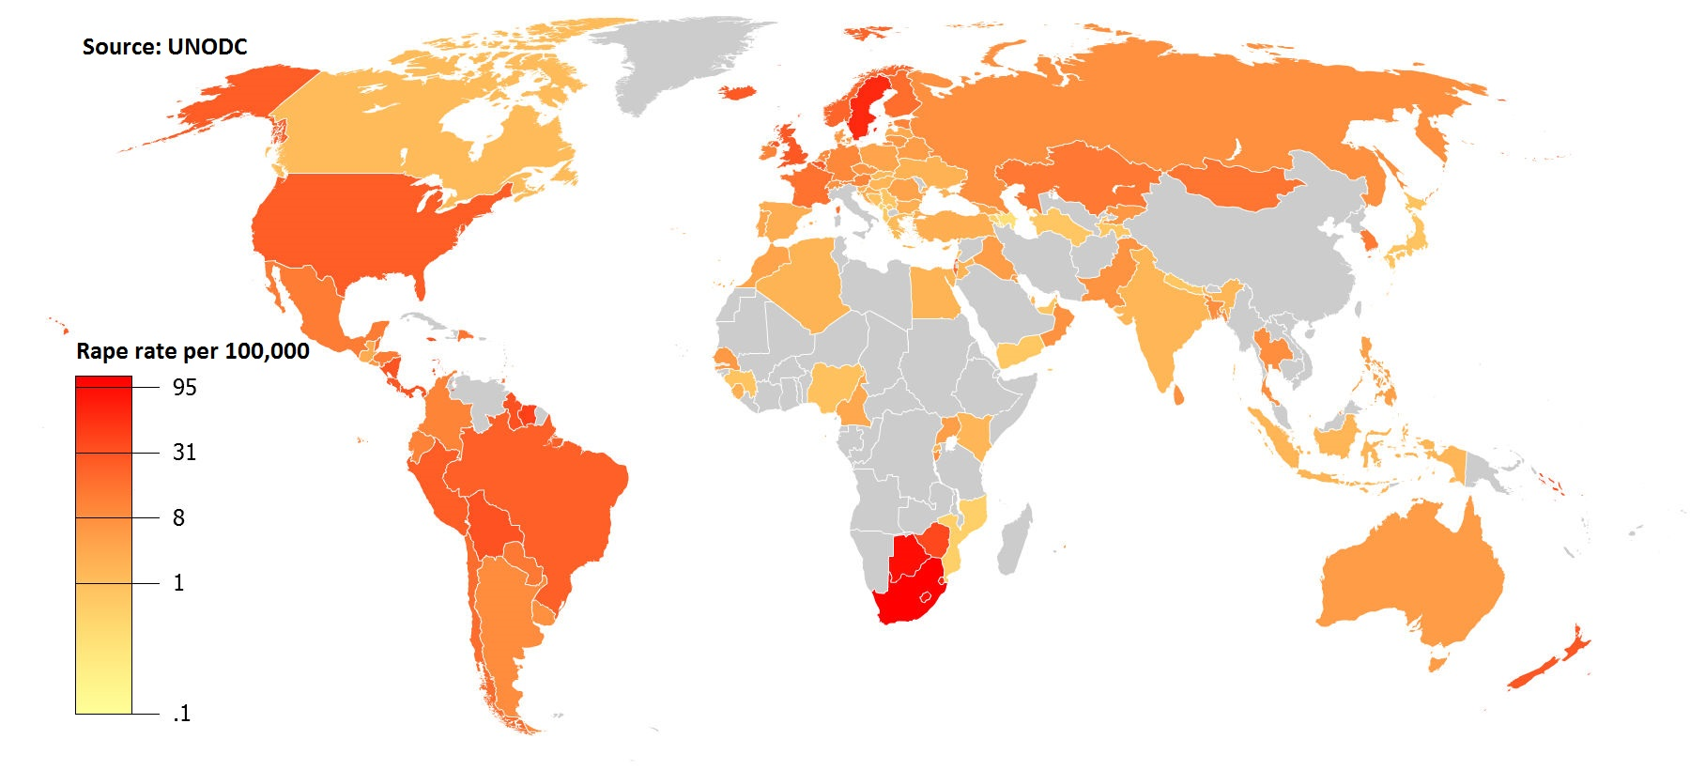
Reported Rape rates per 100,000 population 2010-2012

Slide 5
SCOPE OF THE PROJECT
This serves as an eye opening case study on the categories and frequencies of rape. We have chosen India as our sample. The major problem with rape is that most of the cases go unreported. Given our analysis of the statistics, we aim to ensure that this can aid in increasing encouragement for coming forward with such issues and raise their voices. Based on the frequency in states, the level of security and measures that need to be taken can be made aware.
Since our dataset deals with rape cases from 2001-2010, we plan to compare our analysis of it with the present scenario in order to draw a conclusion on whether the situation has improved or worsened (and in what ways).

Slide 6
DESCRIPTION
Our dataset provides the following information for each state in India 2001 - 2010:
Subgroups: Victims of incestual rape and victims of other rape.
Rape Cases Reported
Victims Above 50 Yrs
Victims Between 10-14 Yrs
Victims Between 14-18 Yrs
Victims Between 18-30 Yrs
Victims Between 30-50 Yrs
Victims of Rape Total
Victims Upto 10 Yrs

Slide 7
PROJECT INFERENCES

Slide 8
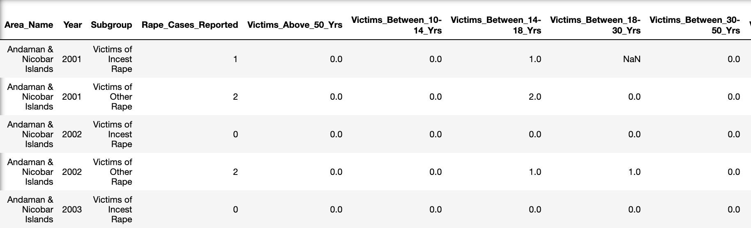
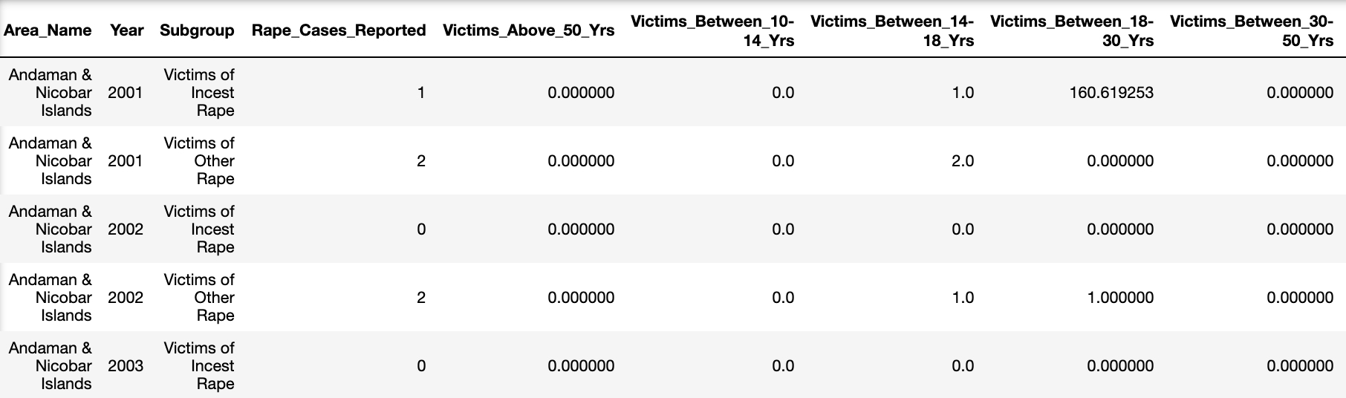
COMPARISON BETWEEN RAW & CLEANED DATASETS

Slide 9
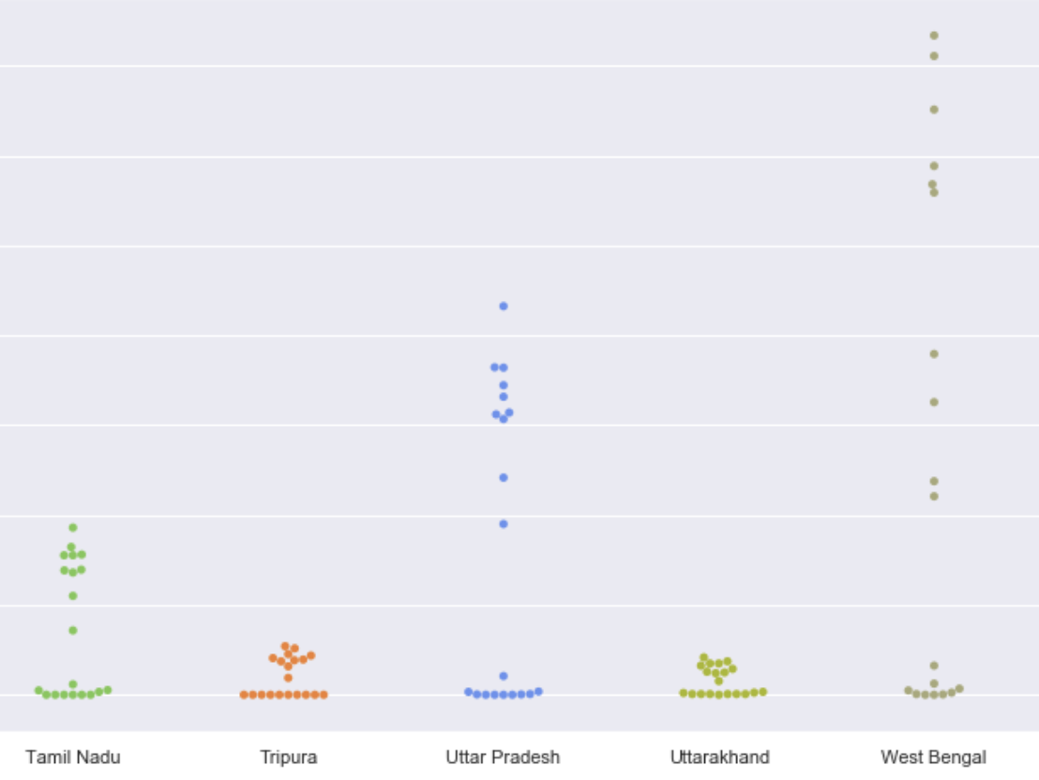
GRAPHS
Graph between states in india and total number of victims in the 18-30 years age group (due to the highest number of reported cases belonging to this age group, as seen in the correlation matrix later).
INFERENCE: Number of rape cases was highest in West Bengal in the 2001-2010 period.

Slide 10
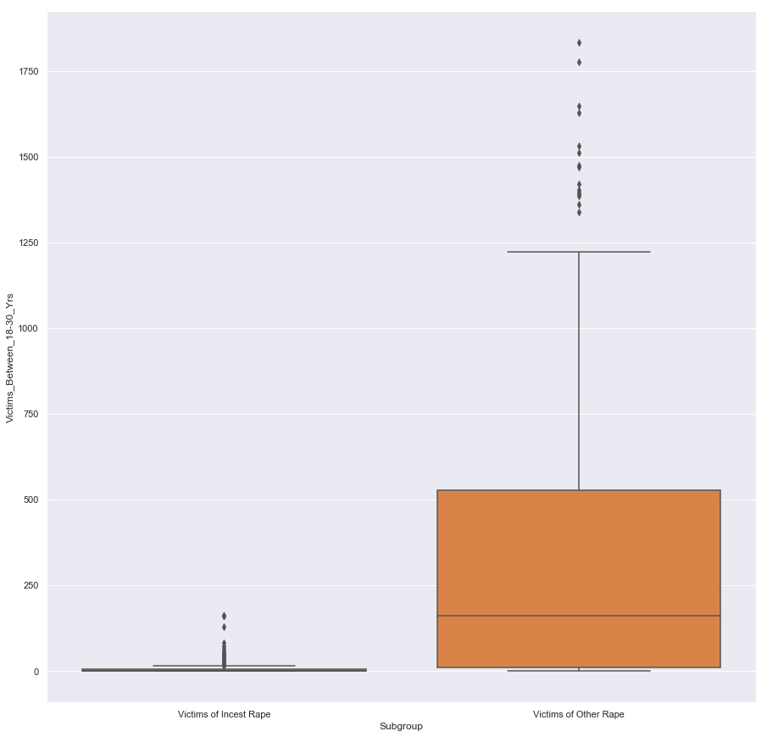
GRAPHS
Graph between two categories of rape - incestual and others - and total number of victims in the 18-30 years age group.
INFERENCE: Number of rape cases is far higher in the ‘Victims of Other Rape’ category.

Slide 11
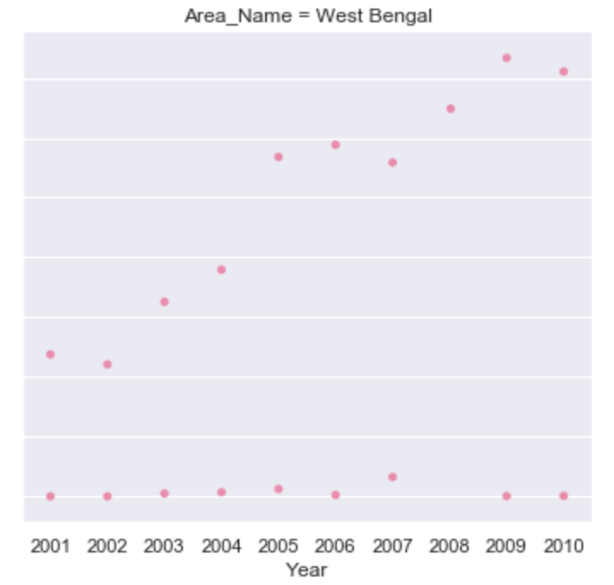
GRAPHS
Graph between the years - 2001 to 2010 - and the total number of victims in the 18-30 years age group for every state.
INFERENCE: Number of rape cases was highest in West Bengal as compared to other states. It was the highest in the year 2009.

Slide 12
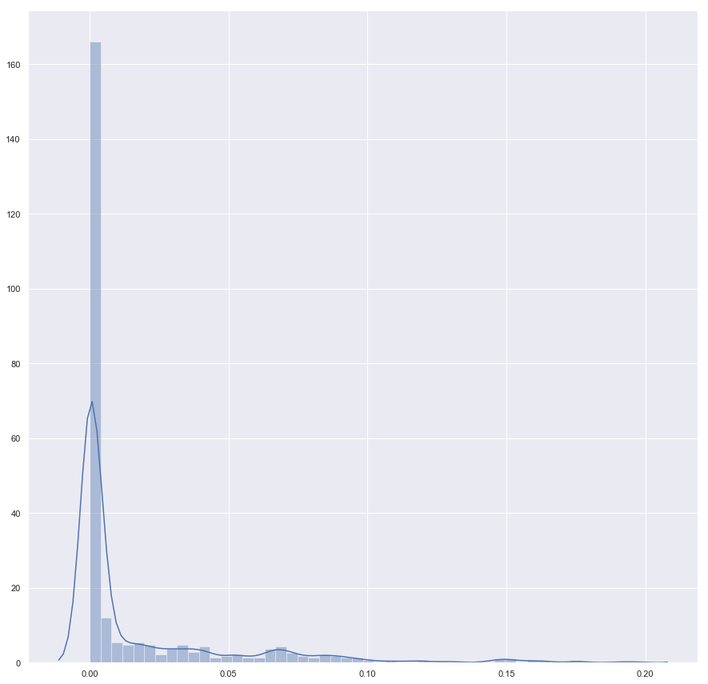
NORMALIZED GRAPH
NOTE: Since our dataset strictly contains positive values, the x axis of the normalized graph does not contain negative values.

Slide 13
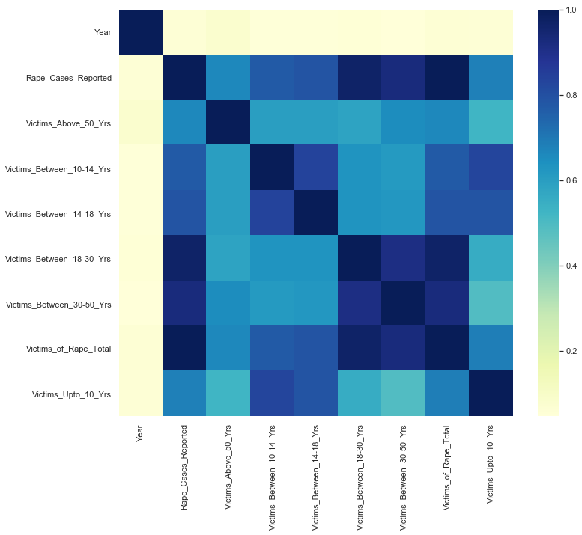
CORRELATION MATRIX
This heatmap represents a correlation matrix between the columns in the dataset.
INFERENCE: The highest number of reported rape cases is from the 18-30 years age group.

Slide 14
CURRENT STATISTICS / PRESENT SCENARIO
The most recent statistics for rape in India show that Madhya Pradesh has the overall highest rate of reported rape cases.
The total number of rape cases in the country has been on the rise since the past decade; some notoriously infamous cases include the gang rape of Nirbhaya in Delhi, rape of a 7 year old girl in Kashmir and the like.
Statisticians have inferred that the unbalanced sex ratio (the number of men exceed the number of women) contributes to higher tendencies of crimes being committed against women. Haryana is reported to have the highest number of GANG rapes in India, and coincidentally, it also has the worst sex ratio.
In conclusion, the situation has worsened for women and children. The number of rape cases in the below 10 age group has seen a disturbing and significant rise in the past decade.

Slide 15
REFERENCES
https://en.wikipedia.org/wiki/Rape_in_India#Rape_statistics
https://www.kaggle.com/rajanand/crime-in-india/download#20_Victims_of_rape.csv
https://adityajzain15.github.io/Rape_In_India/
https://www.livemint.com/opinion/online-views/opinion-the-frequency-illusion-that-tags-india-as-rape-central-1568313932836.html
https://thewire.in/society/a-closer-look-at-statistics-on-sexual-violence-in-india

Slide 16
“ I will never understand why it is more shameful to be raped than to be a rapist.”
Sara Erdmann
Sakshi Shetty (PES1201800190)
Snigdha S Chenjeri (PES1201800045)
Sruthy S (PES1201801143)

